Slide 1

More about OCR Technology
CityU-EE Gifted Education Fund Programme: AIoT Coding, Engineering and Entrepreneurial Skills Education for Gifted Students
Course overview - CityU GEF AIoT 2023
Team Members (Project ID)
27 Lo Pak Ki Kapakki

Slide 2
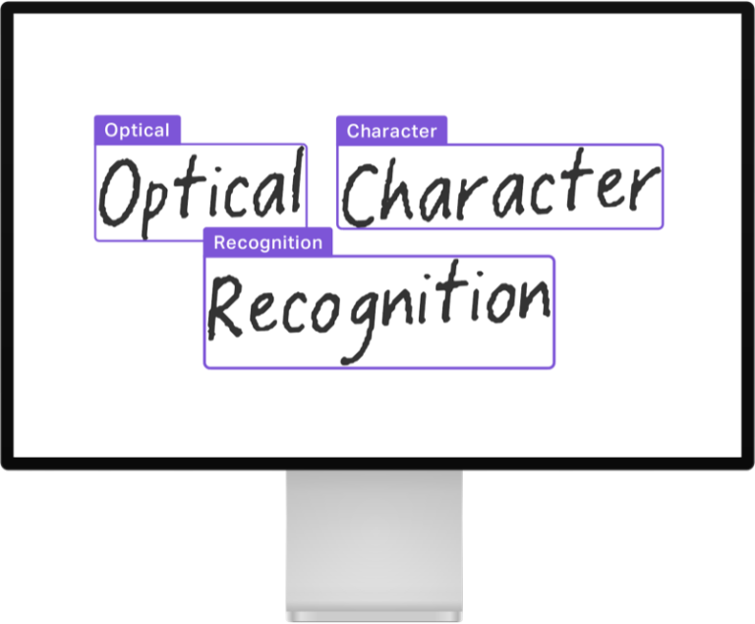
What is OCR?
OCR (Optical Character Recognition)
Input: Picture with text
Output: The text
Analog -> Digital

Slide 3
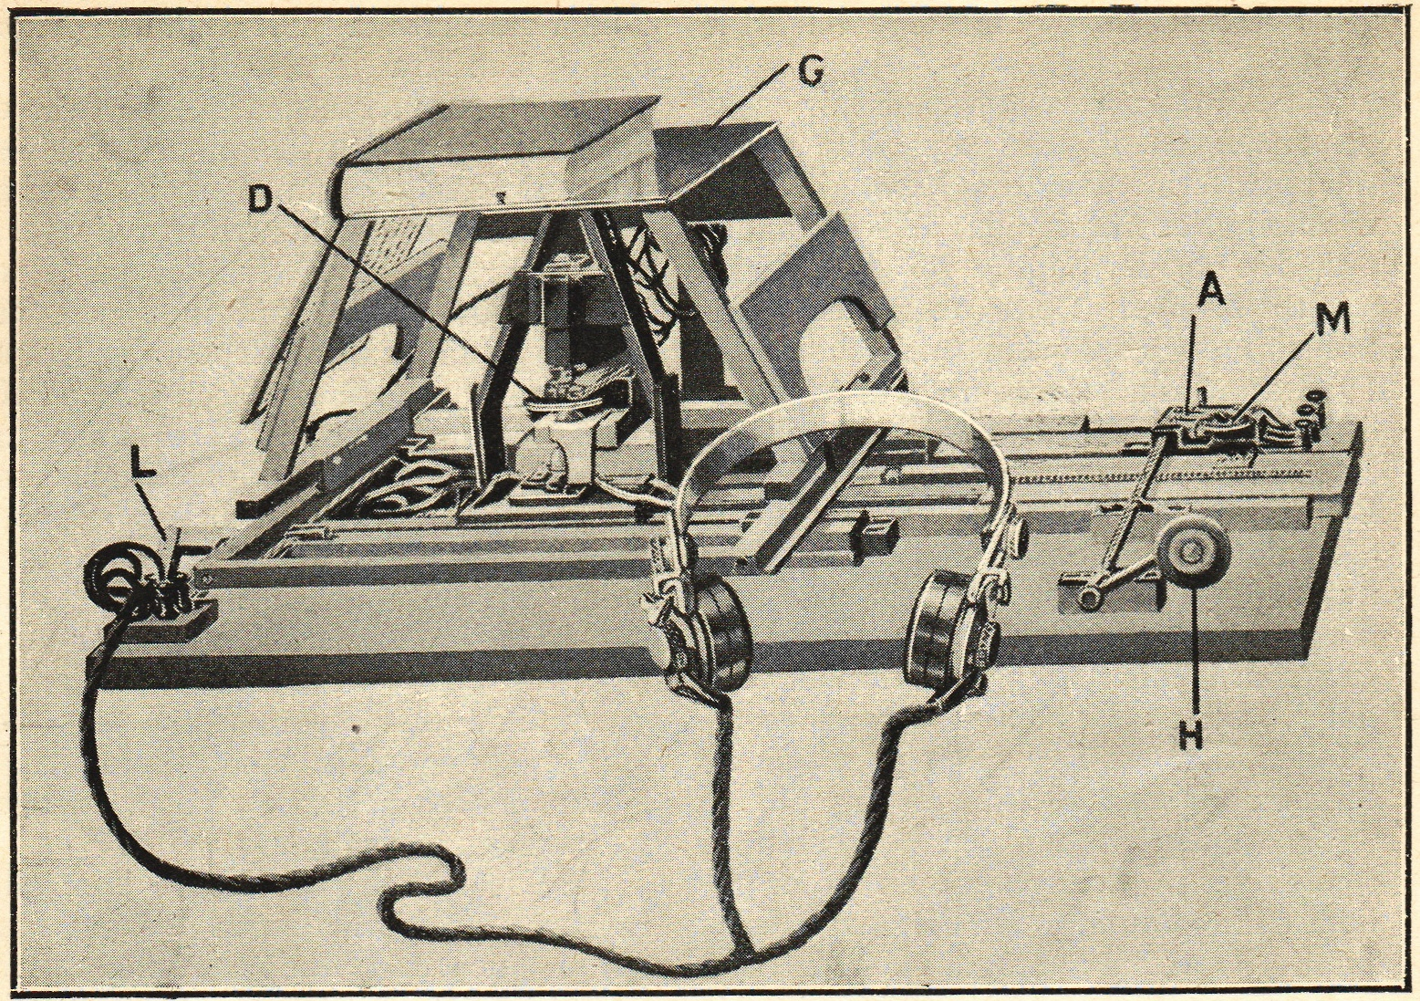
History of OCR
Optophone (1914)
- Uses selenium to
detect black paint, and
recognize characters

Slide 4
Importance
Why is OCR important for humanity?
Encourage Data Preservation

Slide 5
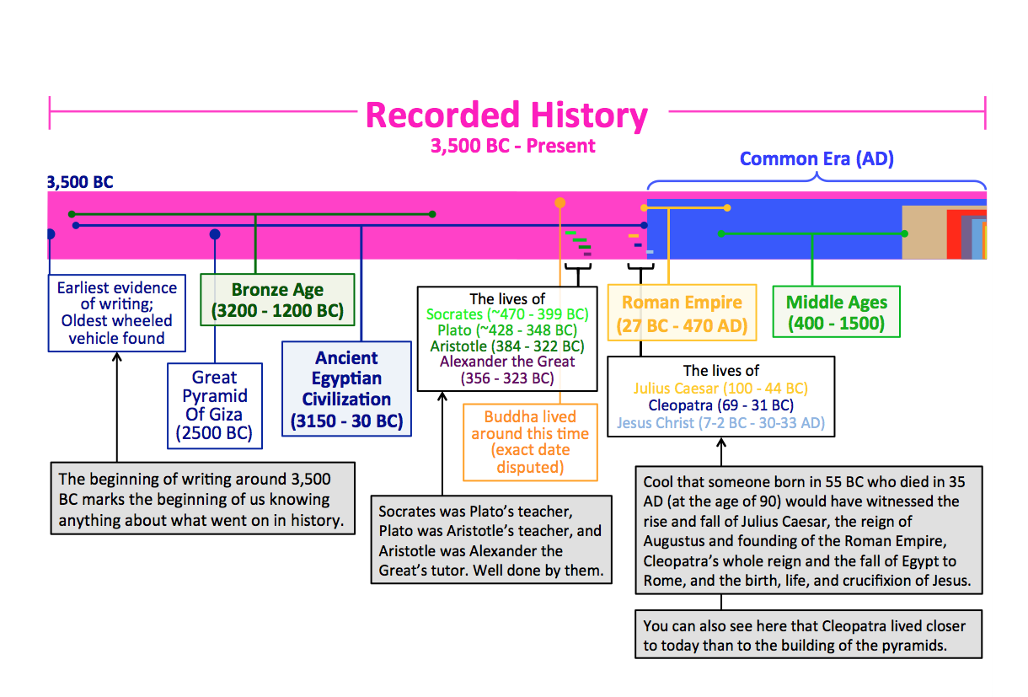

Slide 6
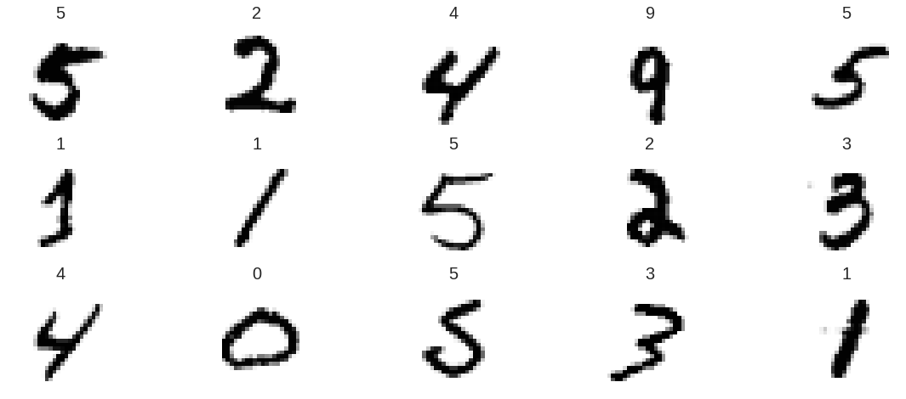
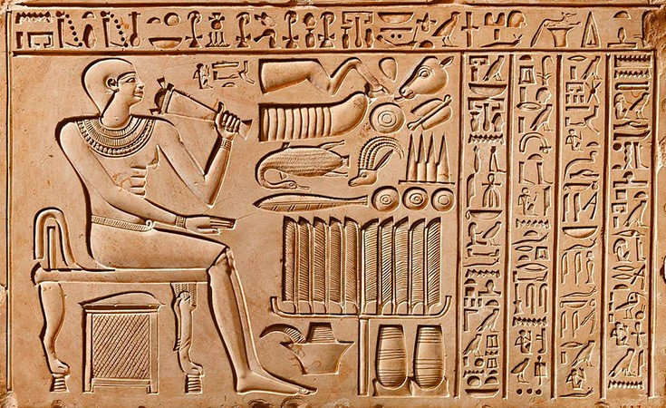
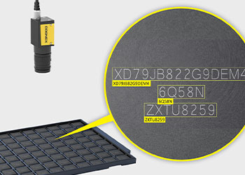
Application of OCR

Slide 7
Creating OCR
Project Phase 1

Slide 8
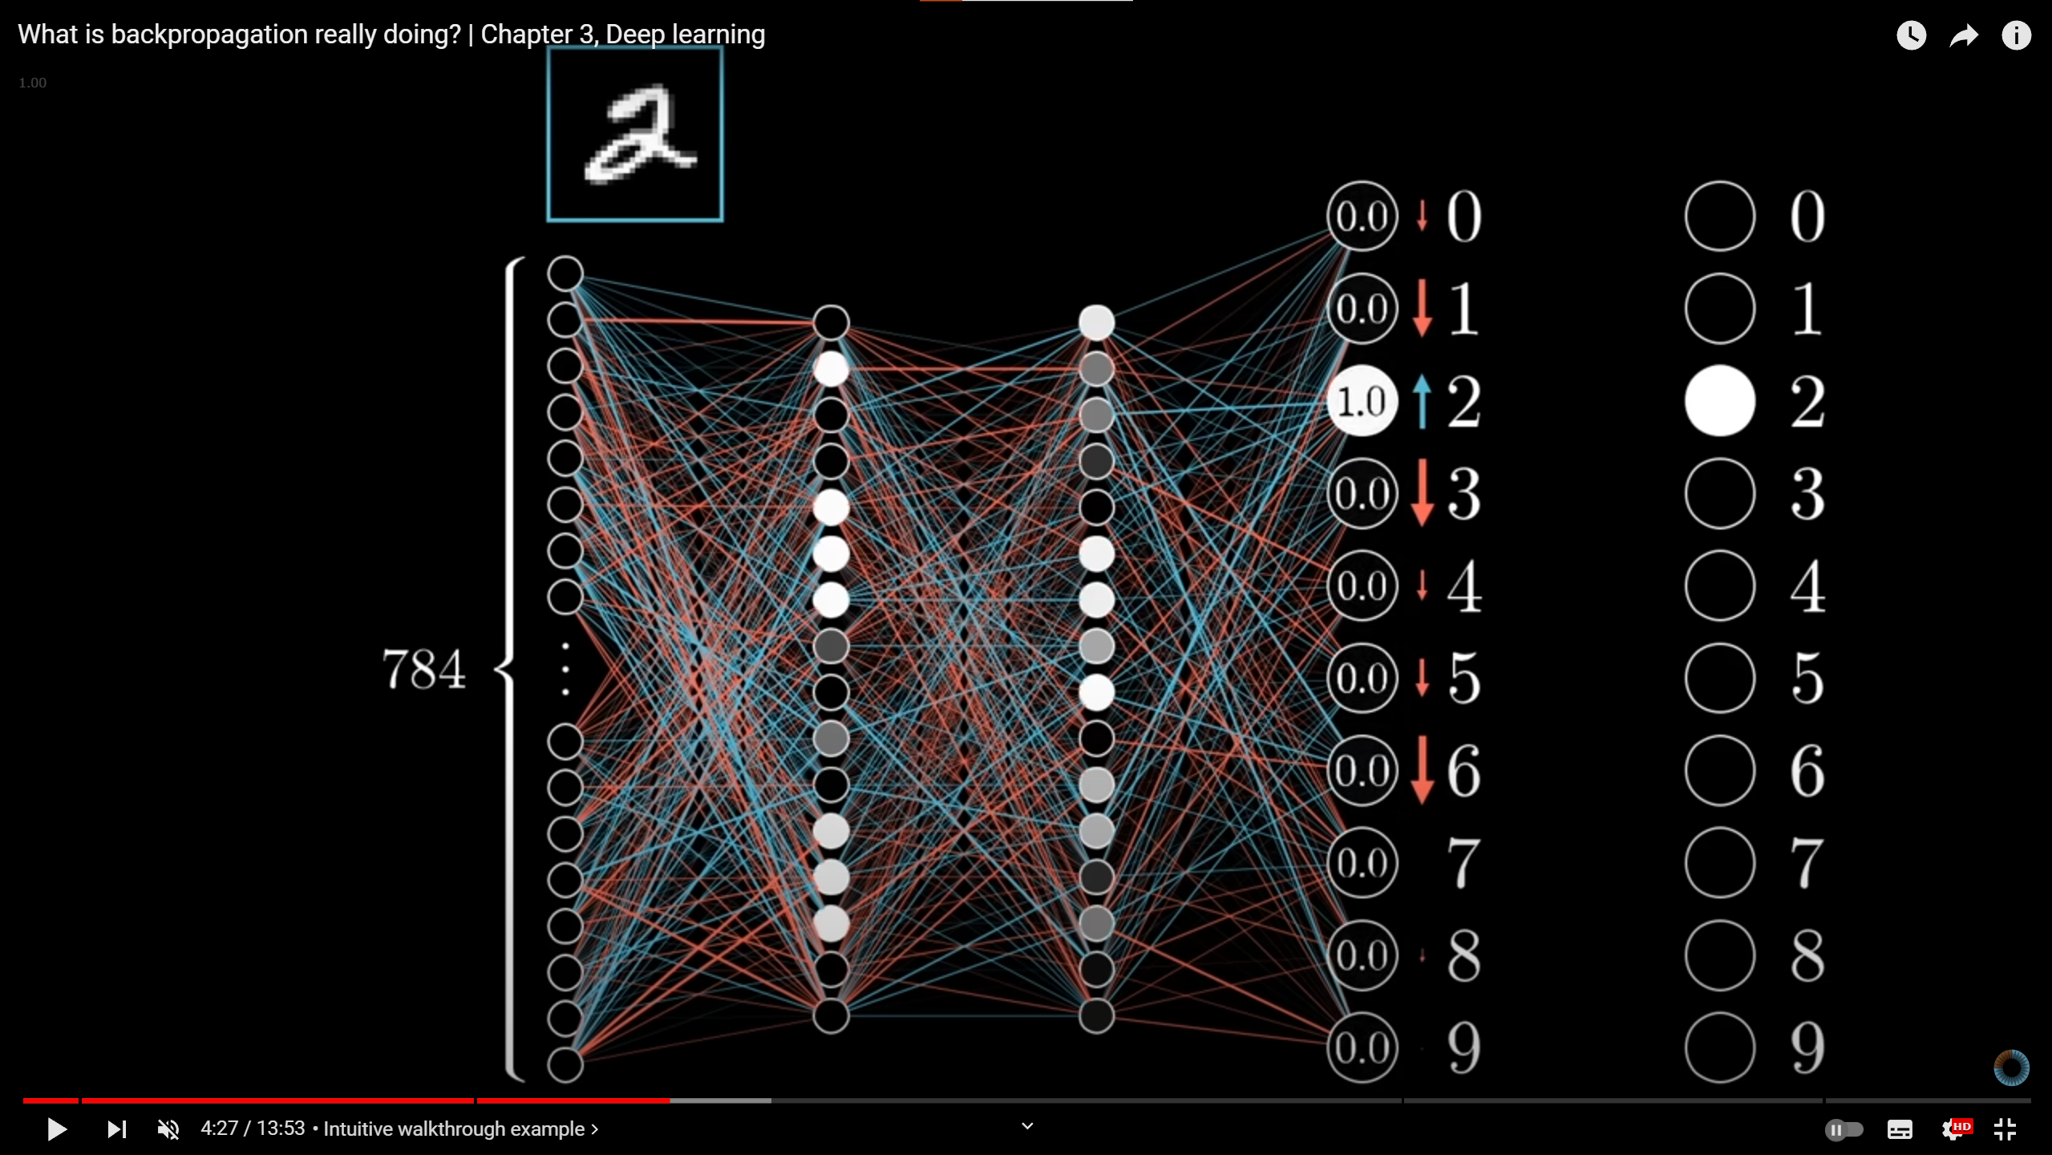
Recognizing Handwritten Digits
Tensorflow MNIST Dataset

Slide 9
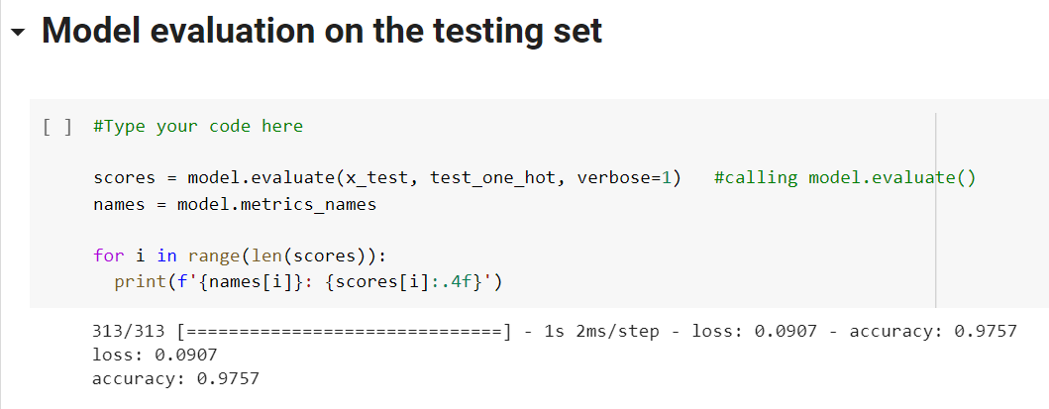

Slide 10
OCR Architectures

Slide 11
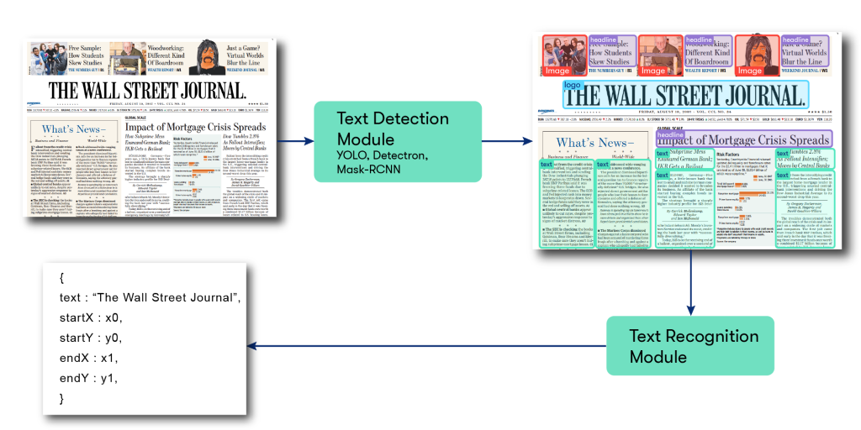
OCR Architecture

Slide 12
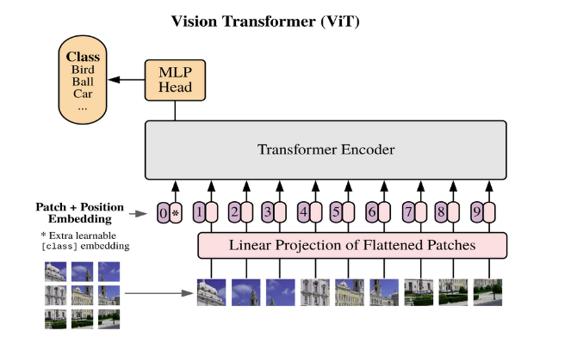
Newer Technologies
Vision Transformers
It is known for being convolution free and
does not require complex
pre or post-processing steps
Is it better?
Depends, it requires a large
dataset to have accurate results

Slide 13
Generative Adverserial Networks (GAN)
Give two inputs, provides us with similar output

Slide 14
Application of GAN
Deepfake Technology
Audio Synthesis

Slide 15
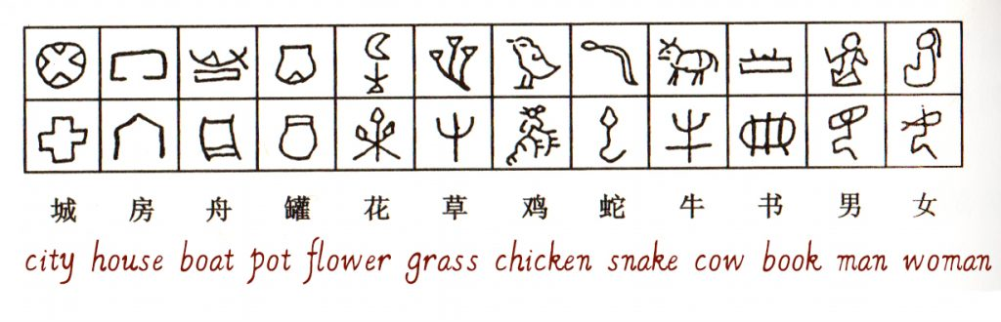
Why is GAN related to OCR?

Slide 16

What is your solution?
Using Changjie Typing System to recognize features of Chinese Characters

Slide 17
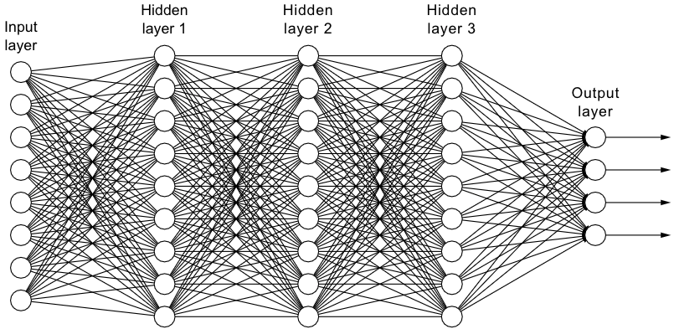
What is your solution?
26+ Times for each
Changjie component
With coordinates detection
Image Input
Changjie Output

Slide 18
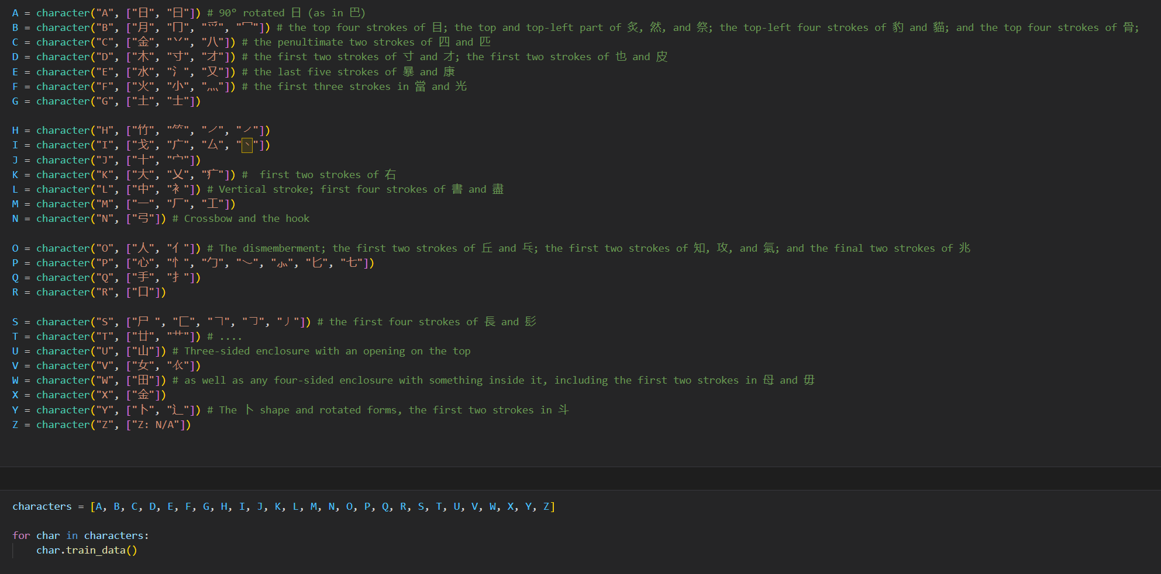

Slide 19
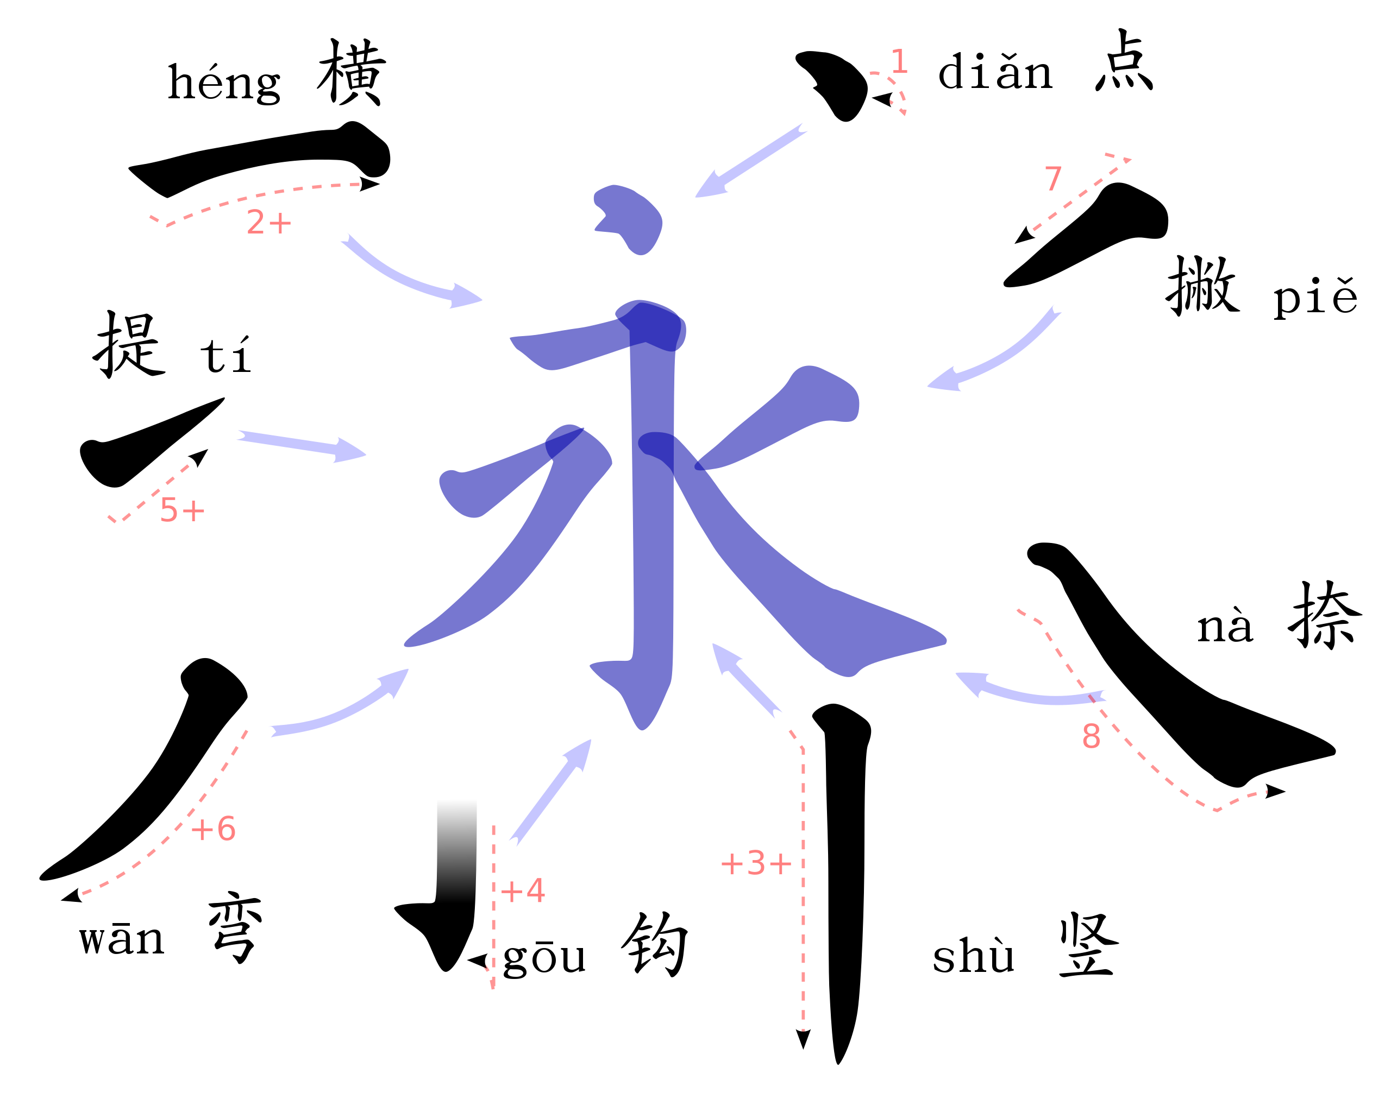
Plan B – 8 Strokes
Recognize the strokes of Chinese Characters
Benefits of this method:
- This is what major Chinese OCR use

Slide 20
Timeline
16 Jan
Currently
(Paused)
After June
2024
Handwritten
Digits (OCR)
Handwritten Characters
Recognize 8 strokes of Chinese
Characters
Making use of GAN in the OCR
system

Slide 21
Thanks!
Any questions?
Contact details:
lokapakki@gmail.com
kapakki.ml (migrating to kapakki.com soon)

